Slide 1
.NET Framework

Slide 2
Topics
Introduction to .NET Framework: Overview of .NET, its history, Architecture and its role in modern software development.
.NET Common Language Runtime (CLR): Understanding how the CLR executes .NET applications and manages memory, exceptions, and security.
FCL
GC (Garbage collector)
CTS, CLS
Visual Studio IDE: Introduction to Visual Studio, the integrated development environment for .NET, and its key features for coding, debugging, and testing.
.NET Assemblies and the GAC: Understanding the concept of assemblies, how they are deployed, and the Global Assembly Cache (GAC).

Slide 3
.Net Framework
.NET Framework is a software development platform created by Microsoft for building and running applications on Windows.
First beta version released in 2000.
.Net framework provides a comprehensive and consistent programming model, allowing developers to write code in multiple languages such as C#, VB.Net, F# and more.
It includes vast collection of libraries, frameworks, and tools.
CLR and BCL core components.
The CLR is the execution environment that manages the execution of .NET applications, providing services such as memory management, security, and exception handling.
Notes:
- .NET Framework is a software development platform created by Microsoft for building and running applications on Windows.
- Introduced in 2002, .NET Framework has evolved over the years and is widely used for developing a variety of applications, including web, desktop, mobile, and cloud-based solutions.
- .NET Framework provides a comprehensive and consistent programming model, allowing developers to write code in multiple languages such as C#, Visual Basic.NET, F#, and more.
- It includes a vast collection of libraries, frameworks, and tools that simplify and accelerate the development process, providing developers with ready-to-use components for common tasks.
- The core components of .NET Framework include the Common Language Runtime (CLR), Base Class Library (BCL), and a range of application frameworks such as ASP.NET for web development and Windows Forms and WPF for desktop applications.
- The CLR is the execution environment that manages the execution of .NET applications, providing services such as memory management, security, and exception handling.
- The BCL is a set of classes and APIs that provide fundamental functionality for developing applications, including data access, networking, file I/O, and more.
- The architecture of .NET Framework follows a managed code model, where applications are compiled into Intermediate Language (IL) code, which is then executed by the CLR at runtime.
- .NET Framework promotes code interoperability and language independence, allowing developers to integrate components written in different languages seamlessly.
- In modern software development, .NET Framework plays a significant role as it enables developers to build robust, scalable, and secure applications across various platforms and domains.
- With the introduction of newer versions of .NET, such as .NET Core and .NET 5/6, Microsoft has focused on enhancing performance, scalability, and cross-platform capabilities, making .NET an even more versatile and powerful framework.
- .NET Framework integrates with a wide range of development tools, including Microsoft Visual Studio, a comprehensive IDE that provides features like code editing, debugging, and project management.
- Microsoft Azure, a cloud computing platform, also supports .NET, allowing developers to deploy and host their .NET applications in the cloud environment.

Slide 4
Continue…
The BCL is a set of classes and APIs that provide fundamental functionality for developing applications, including data access, networking, file I/O, and more.
The architecture of .NET Framework follows a managed code model, where applications are compiled into Intermediate Language (IL) code, which is then executed by the CLR at runtime.
NET Framework promotes code interoperability and language independence, allowing developers to integrate components written in different languages seamlessly.
In modern software development, .NET Framework plays a significant role, enabling developers to build robust, scalable, and secure applications across various platforms and domains.

Slide 5
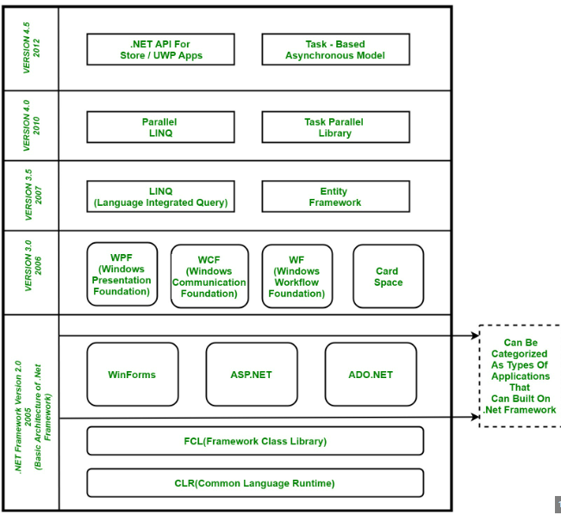
.Net Framework Architecture
Notes:
UWP -> Universal windows platform apps, The .NET Framework is composed of four main components:
Common Language Runtime (CLR)
Framework Class Library (FCL),
Core Languages (WinForms, ASP.NET, and ADO.NET), and
Other Modules (WCF, WPF, WF, Card Space, LINQ, Entity Framework, Parallel LINQ, Task Parallel Library, etc.)
CLR (Common Language Runtime)
It is a program execution engine that loads and executes the program. It converts the program into native code. It acts as an interface between the framework and operating system. It does exception handling, memory management, and garbage collection. Moreover, it provides security, type-safety, interoperability, and portablility.
FCL (Framework Class Library)
It is a standard library that is a collection of thousands of classes and used to build an application. The BCL (Base Class Library) is the core of the FCL and provides basic functionalities.
WinForms
Windows Forms is a smart client technology for the .NET Framework, a set of managed libraries that simplify common application tasks such as reading and writing to the file system.
ASP.NET
ASP.NET is a web framework designed and developed by Microsoft. It is used to develop websites, web applications, and web services. It provides a fantastic integration of HTML, CSS, and JavaScript. It was first released in January 2002.
ADO.NET
ADO.NET is a module of .Net Framework, which is used to establish a connection between application and data sources. Data sources can be such as SQL Server and XML. ADO .NET consists of classes that can be used to connect, retrieve, insert, and delete data.
WPF (Windows Presentation Foundation)
Windows Presentation Foundation (WPF) is a graphical subsystem by Microsoft for rendering user interfaces in Windows-based applications. WPF, previously known as "Avalon", was initially released as part of .NET Framework 3.0 in 2006. WPF uses DirectX.
WCF (Windows Communication Foundation)
It is a framework for building service-oriented applications. Using WCF, you can send data as asynchronous messages from one service endpoint to another.
WF (Workflow Foundation)
Windows Workflow Foundation (WF) is a Microsoft technology that provides an API, an in-process workflow engine, and a rehostable designer to implement long-running processes as workflows within .NET applications.
LINQ (Language Integrated Query)
It is a query language, introduced in .NET 3.5 framework. It is used to make the query for data sources with C# or Visual Basics programming languages.
Entity Framework
It is an ORM based open source framework which is used to work with a database using .NET objects. It eliminates a lot of developers effort to handle the database. It is Microsoft's recommended technology to deal with the database.
Parallel LINQ
Parallel LINQ or PLINQ is a parallel implementation of LINQ to objects. It combines the simplicity and readability of LINQ and provides the power of parallel programming.
It can improve and provide fast speed to execute the LINQ query by using all available computer capabilities.
Apart from the above features and libraries, .NET includes other APIs and Model to improve and enhance the .NET framework.

Slide 6
CLR (Common Language Runtime)
.Net CLR is a runtime environment that manages and executes the code written in any .net programming language
CLR is the virtual machine component of the .NET framework.
The Language compiler complies the source code to MSIL (Microsoft Intermediate language)
MSIL code is Platform independent and its stored in a Manifest file.
JIT (Just-in-time complier) component of CLR converts MSIL code into native code.
CLR manages memory, threads, exceptions, code execution, code safety, verification, and compilation.
Notes:
.NET CLR is a runtime environment that manages and executes the code written in any .NET programming language. CLR is the virtual machine component of the .NET framework. That language's compiler compiles the source code of applications developed using .NET compliant languages into CLR's intermediate language called MSIL, i.e., Microsoft intermediate language code. This code is platform-independent. It is comparable to byte code in java. Metadata is also generated during compilation and MSIL code and stored in a file known as the Manifest file. This metadata is generally about members and types required by CLR to execute MSIL code. A just-in-time compiler component of CLR converts MSIL code into native code of the machine. This code is platform-dependent. CLR manages memory, threads, exceptions, code execution, code safety, verification, and compilation.

Slide 7

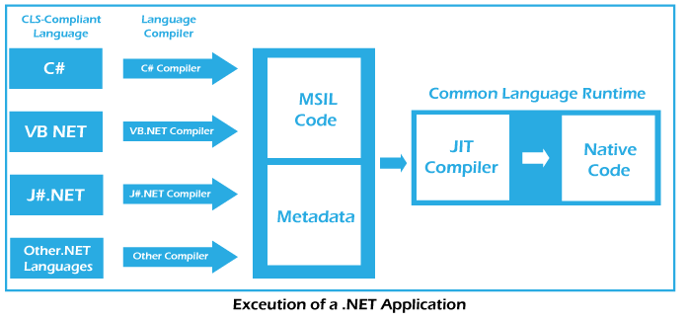
Converting Source code into Native code

Slide 8
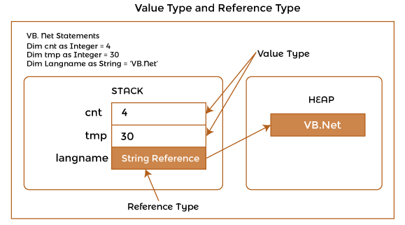
Components of CLR
The main components of CLR are :
Common type system (CTS)
Common language speciation (CLS)
Garbage Collector (GC)
Just in Time Compiler (JIT)
Metadata and Assemblies
Notes:
1. Common type system:
CTS provides guidelines for declaring, using, and managing data types at runtime. It offers cross-language communication. For example, VB.NET has an integer data type, and C# has an int data type for managing integers. After compilation, Int32 is used by both data types. So, CTS provides the data types using managed code. A common type system helps in writing language-independent code.
It provides two categories of Types.
Value Type: A value type stores the data in memory allocated on the stack or inline in a structure. This category of Type holds the data directory. If one variable's value is copied to another, both the variables store data independently. It can be of inbuilt-in types, user-defined, or enumerations types. Built-in types are primitive data types like numeric, Boolean, char, and date. Users in the source code create user-defined types. An enumeration refers to a set of enumerated values represented by labels but stored as a numeric type.
Reference Type: A Reference type stores a reference to the value of a memory address and is allocated on the heap. Heap memory is used for dynamic memory allocation. Reference Type does not hold actual data directly but holds the address of data. Whenever a reference type object is made, it copies the address and not actual data. Therefore two variables will refer to the same data. If data of one Reference Type object is changed, the same is reflected for the other object. Reference types can be self-describing types, pointer types, or interference types. The self-describing types may be string, array, and class types that store metadata about themselves.
2. Common Language Specification (CLS):
Common Language Specification (CLS) contains a set of rules to be followed by all NET-supported languages. The common rules make it easy to implement language integration and help in cross-language inheritance and debugging. Each language supported by NET Framework has its own syntax rules. But CLS ensures interoperability among applications developed using NET languages.
3. Garbage Collection:
Garbage Collector is a component of CLR that works as an automatic memory manager. It helps manage memory by automatically allocating memory according to the requirement. It allocates heap memory to objects. When objects are not in use, it reclaims the memory allocated to them for future use. It also ensures the safety of objects by not allowing one object to use the content of another object.
4. Just in Time (JIT) Compiler:
JIT Compiler is an important component of CLR. It converts the MSIL code into native code (i.e., machine-specific code). The .NET program is compiled either explicitly or implicitly. The developer or programmer calls a particular compiler to compile the program in the explicit compilation. In implicit compilation, the program is compiled twice. The source code is compiled into Microsoft Intermediate Language (MSIL) during the first compilation process. The MSIL code is converted into native code in the second compilation process. This process is called JIT compilation. There are three types of JIT compilers -Pre, Econo, and Normal. Pre JIT Compiler compiles entire MSIL code into native code before execution. Econo JIT Compiler compiles only those parts of MSIL code required during execution and removes those parts that are not required anymore. Normal JIT Compiler also compiles only those parts of MSIL code required during execution but places them in cache for future use. It does not require recompilations of already used parts as they have been placed in cache memory.
5. Metadata:
A Metadata is a binary information about the program, either stored in a CLR Portable Executable file (PE) along with MSIL code or in the memory. During the execution of MSIL, metadata is also loaded into memory for proper interpretation of classes and related. Information used in code. So, metadata helps implement code in a language-neutral manner or achieve language interoperability.
6. Assemblies:
An assembly is a fundamental unit of physical code grouping. It consists of the assembly manifest, metadata, MSIL code, and a set of resources like image files. It is also considered a basic deployment unit, version control, reuse, security permissions, etc.

Slide 9
.NET CLR Functions
It converts the program into native code.
Handles Exceptions
Provides type-safety
Memory management
Provides security
Improved performance
Language independent
Platform independent
Garbage collection
Provides language features such as inheritance, interfaces, and overloading for object-oriented programs.

Slide 10
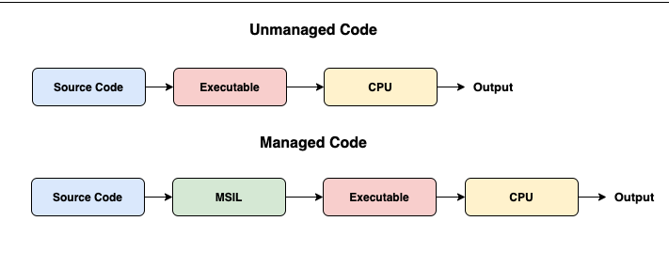
Managed Code & Unmanaged Code
Notes:
1. Managed code:
Any language that is written in the .NET framework is managed code. Managed code use CLR, which looks after your applications by managing memory, handling security, allowing cross-language debugging, etc.
What are the advantages of using Managed Code?
It improves the security of the application like when you use runtime environment, it automatically checks the memory buffers to guard against buffer overflow.
It implement the garbage collection automatically.
It also provides runtime type checking/dynamic type checking.
It also provides reference checking which means it checks whether the reference point to the valid object or not and also check they are not duplicate.
What are the disadvantages of Managed Code?
The main disadvantage of managed language is that you are not allowed to allocate memory directly, or you cannot get the low-level access of the CPU architecture.
2. Unmanaged code:
The code developed outside the .NET framework is known as unmanaged code. Applications that do not run under the control of the CLR are said to be unmanaged. Certain languages such as C++ can be used to write such applications, such as low-level access functions of the operating system. Background compatibility with VB, ASP, and COM are examples of unmanaged code. This code is executed with the help of wrapper classes
What are the advantages of using Unmanaged Code?
It provides the low-level access to the programmer.
It also provides direct access to the hardware.
It allows the programmer to bypass some parameters and restriction that are used by the managed code framework.
What are the disadvantages of Unmanaged Code?
It does not provide security to the application.
Due to the access to memory allocation the issues related to memory occur like memory buffer overflow, etc.
Error and exceptions are also handled by the programmer.
It does not focus on garbage collection.

Slide 11
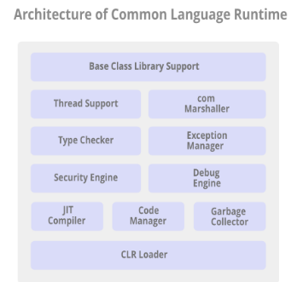
.NET CLR Structure
Notes:
Base Class Library Support: The Common Language Runtime provides support for the base class library. The BCL contains multiple libraries that provide various features such as Collections, I/O, XML, DataType definitions, etc. for the multiple .NET programming languages.
Thread Support: The CLR provides thread support for managing the parallel execution of multiple threads. The System.Threading class is used as the base class for this.
COM Marshaller: Communication with the COM (Component Object Model) component in the .NET application is provided using the COM marshaller. This provides the COM interoperability support.
Type Checker: Type safety is provided by the type checker by using the Common Type System (CTS) and the Common Language Specification (CLS) that are provided in the CLR to verify the types that are used in an application.
Exception Manager: The exception manager in the CLR handles the exceptions regardless of the .NET Language that created them. For a particular application, the catch block of the exceptions are executed in case they occur and if there is no catch block then the application is terminated.
Security Engine: The security engine in the CLR handles the security permissions at various levels such as the code level, folder level, and machine level. This is done using the various tools that are provided in the .NET framework.
Debug Engine: An application can be debugged during the run-time using the debug engine. There are various ICorDebug interfaces that are used to track the managed code of the application that is being debugged.
JIT Compiler: The JIT compiler in the CLR converts the Microsoft Intermediate Language (MSIL) into the machine code that is specific to the computer environment that the JIT compiler runs on. The compiled MSIL is stored so that it is available for subsequent calls if required.
Code Manager: The code manager in CLR manages the code developed in the .NET framework i.e. the managed code. The managed code is converted to intermediate language by a language-specific compiler and then the intermediate language is converted into the machine code by the Just-In-Time (JIT) compiler.
Garbage Collector: Automatic memory management is made possible using the garbage collector in CLR. The garbage collector automatically releases the memory space after it is no longer required so that it can be reallocated.
CLR Loader: Various modules, resources, assemblies, etc. are loaded by the CLR loader. Also, this loader loads the modules on demand if they are actually required so that the program initialization time is faster and the resources consumed are lesser.

Slide 12
.Net Framework Class Library
.NET Framework Class Library is the collection of classes, namespaces, interfaces and value types that are used for .NET applications.
It contains thousands of classes that supports the following functions.
Base and user-defined data types
Support for exceptions handling
input/output and stream operations
Communications with the underlying system
Access to data
Ability to create Windows-based GUI applications
Ability to create web-client and server applications
Support for creating web services

Slide 13
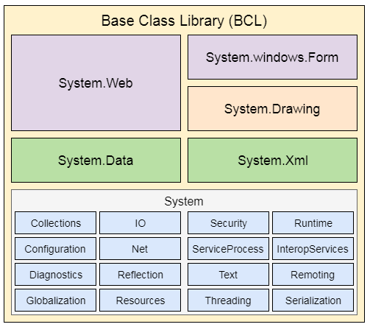
.NET Framework Base Class Library
.NET Base Class Library is the sub-part of the Framework that provides library support for Common Language Runtime to work properly. It includes the System namespace and core types of the .NET framework.

Slide 14
Garbage Collector
Garbage collection is a memory management technique used in the .NET Framework and many other programming languages.
The garbage collector works by periodically scanning the application’s memory to determine which objects are still being used and which are no longer needed.
Objects that are no longer being used are marked for garbage collection, and their memory is freed up automatically by the garbage collector.

Slide 15
GC continue…
Key Features
Automatic memory management.
Low impact on application performance
Generation based collection
Finalization
Notes:
Some of the key features of the garbage collector in C# include:
Automatic memory management: With the garbage collector, developers don’t need to worry about manually allocating or freeing up memory. The garbage collector takes care of memory management automatically, which can help reduce the risk of memory leaks and other issues.
Low impact on application performance: The garbage collector runs in the background and typically has a low impact on application performance. However, in some cases, garbage collection can cause brief pauses or slowdowns in the application, particularly when large amounts of memory need to be freed up at once.
Generation-based collection: The garbage collector in C# uses a generation-based approach to memory management. Objects are initially allocated in a “young” generation and are moved to an “old” generation if they survive multiple garbage collection cycles. This approach helps reduce the amount of time required for garbage collection, as most objects are collected in the young generation.
Finalization: The garbage collector also provides support for finalization, which is a process that allows objects to perform cleanup tasks before they are destroyed. Objects with finalizers are moved to a separate finalization queue, which is processed by the garbage collector after all other objects have been collected.

Slide 16
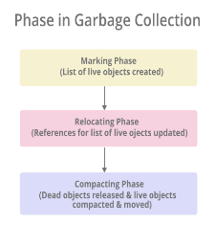
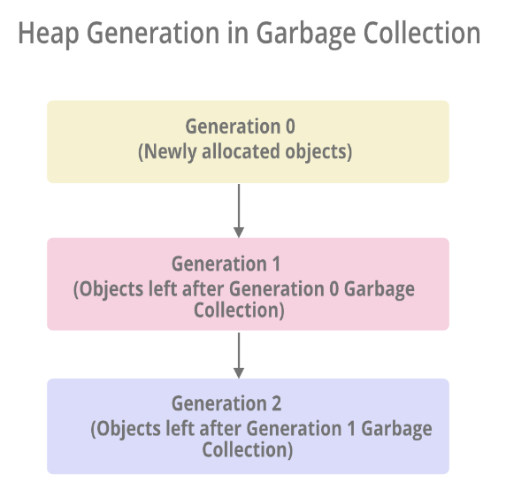
Phase in GC
There are mainly 3 phases in garbage collection.
Generation 2 > Generation 1 > Generation 0
Notes:
Marking Phase: A list of all the live objects is created during the marking phase. This is done by following the references from all the root objects. All of the objects that are not on the list of live objects are potentially deleted from the heap memory.
Relocating Phase: The references of all the objects that were on the list of all the live objects are updated in the relocating phase so that they point to the new location where the objects will be relocated to in the compacting phase.
Compacting Phase: The heap gets compacted in the compacting phase as the space occupied by the dead objects is released and the live objects remaining are moved. All the live objects that remain after the garbage collection are moved towards the older end of the heap memory in their original order.
The heap memory is organized into 3 generations so that various objects with different lifetimes can be handled appropriately during garbage collection. The memory to each Generation will be given by the Common Language Runtime(CLR) depending on the project size. Internally, Optimization Engine will call the Collection Means Method to select which objects will go into Generation 1 or Generation 2.
Generation 0 : All the short-lived objects such as temporary variables are contained in the generation 0 of the heap memory. All the newly allocated objects are also generation 0 objects implicitly unless they are large objects. In general, the frequency of garbage collection is the highest in generation 0.
Generation 1 : If space occupied by some generation 0 objects that are not released in a garbage collection run, then these objects get moved to generation 1. The objects in this generation are a sort of buffer between the short-lived objects in generation 0 and the long-lived objects in generation 2.
Generation 2 : If space occupied by some generation 1 objects that are not released in the next garbage collection run, then these objects get moved to generation 2. The objects in generation 2 are long lived such as static objects as they remain in the heap memory for the whole process duration.
Note: Garbage collection of a generation implies the garbage collection of all its younger generations. This means that all the objects in that particular generation and its younger generations are released. Because of this reason, the garbage collection of generation 2 is called a full garbage collection as all the objects in the heap memory are.released. Also, the memory allocated to the Generation 2 will be greater than Generation 1’s memory and similarly the memory of Generation 1 will be greater than Generation 0’s memory(Generation 2 > Generation 1 > Generation 0).

Slide 17
Benefits of GC
Garbage Collection succeeds in allocating objects efficiently on the heap memory using the generations of garbage collection.
Manual freeing of memory is not needed as garbage collection automatically releases the memory space after it is no longer required.
Garbage collection handles memory allocation safely so that no object uses the contents of another object mistakenly.
The constructors of newly created objects do not have to initialize all the data fields as garbage collection clears the memory of objects that were previously released.

Slide 18
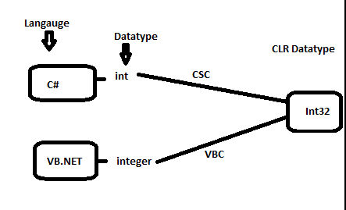
Common Type System
The CTS is a standard which defines how the types are declared, used and managed in the CLR.
CTS defines the basic data types that IL understands.
Value Type : Contains the value that need to be stored directly on the stack or allocated inline in a structure.
Reference Type : Stores a reference to the values Memory address and are allocated on the heap

Slide 19
Common Language Specfication
CLS is the collection of the rules and constraints that every language (that seeks to achevie .Net compatibility) must follow.
CLS is nothing but guidelines that language to follow so that it can communicate with other .Net languages in a seamless manner.
It is a subset of the CTS.

Slide 20
Intro Visual Studio IDE

Slide 21
What is a .Net Assembly?
The .NET assembly is the standard for components developed with the Microsoft.NET. Dot NET assemblies may or may not be executable, i.e., they might exist as the executable (.exe) file or dynamic link library (DLL) file.
.NET supports three kinds of assemblies:
private
shared
Satellite
Notes:
The .NET assembly is the standard for components developed with the Microsoft.NET. Dot NET assemblies may or may not be executable, i.e., they might exist as the executable (.exe) file or dynamic link library (DLL) file.
All the .NET assemblies contain the definition of types, versioning information for the type, meta-data, and manifest. The designers of .NET have worked a lot on the component (assembly) resolution.
An assembly can be a single file or it may consist of the multiple files. In the case of multi-file, there is one master module containing the manifest while other assemblies exist as non-manifest modules. A module in .NET is a subpart of a multi-file .NET assembly. Assembly is one of the most interesting and extremely useful areas of .NET architecture along with reflections and attributes.
.NET supports three kinds of assemblies:
private
shared
satellite
Private Assembly
Private assembly requires us to copy separately in all application folders where we want to use that assembly’s functionalities; without copying, we cannot access the private assembly features and power. Private assembly means every time we have one, we exclusively copy into the BIN folder of each application folder.
Public Assembly
Public assembly is not required to copy separately into all application folders. Public assembly is also called Shared Assembly. Only one copy is required in system level, there is no need to copy the assembly into the application folder.
Public assembly should install in GAC.
Shared assemblies (also called strong named assemblies) are copied to a single location (usually the Global assembly cache). For all calling assemblies within the same application, the same copy of the shared assembly is used from its original location. Hence, shared assemblies are not copied in the private folders of each calling assembly. Each shared assembly has a four-part name including its face name, version, public key token, and culture information. The public key token and version information makes it almost impossible for two different assemblies with the same name or for two similar assemblies with a different version to mix with each other.
GAC (Global Assembly Cache)
When the assembly is required for more than one project or application, we need to make the assembly with a strong name and keep it in GAC or in the Assembly folder by installing the assembly with the GACUtil command.
Satellite Assembly
Satellite assemblies are used for deploying language and culture-specific resources for an application.

Slide 22
ILDASM and ILASM
Any .Net application – compile – Assembly (.EXE or .DLL)
Assembly contains –Manifest and IL
Some information in the assembly manifest can be modified using attributes.
ILDASM(Internediate Language Disassembler) is used to peek at the assembly manifest and IL. This tool can be used to export manifest and IL to a text file.,
ILASM.exe (Intermediate Language Assembler) is used to reconstruct an assembly from a text file that contains manifest and IL
Note : Run ildasm.exe assemblyname.exe to disassembly
Run ilasm.exe fullyqualified
Notes:
h

Slide 23
GAC – Global Assembly Cache
GAC contains strong-named assemblies. Assemblies in the GAC can be shared by all applications running on that machine, without having to copy the assembly locally.
Its recommended to install an assembly into GAC, only when required and shared by applications, otherwise they should be kept private.
C:\Windows\assembly →For .NET 2.0-3.5 assemblies
C:\Windows\Microsoft.NET\assembly → For .NET 4.0 assemblies
To Install assembly use gacutil.exe –i assemblyname.dll
To uninstall assembly use gacutil.exe –u asseblyname
Note: Only strong-named assemblies can be deployed in GAC
C:\windows\system32>sn.exe -k c:\SampleStrongKeys.snk
Notes:
GAC stands for Global Assembly Cache. The Global Assembly Cache is a machine-wide cache that stores assemblies, which are the fundamental units of deployment and versioning in .NET.
When you develop applications in .NET, you typically compile your code into assemblies, which are files with the .dll or .exe extension. Assemblies contain compiled code, resources, and metadata that describe the types and dependencies of your application.
The Global Assembly Cache provides a centralized location for storing and sharing assemblies across multiple applications on a computer. By placing an assembly in the GAC, you make it globally accessible to any .NET application running on that machine. This eliminates the need to copy the assembly into the application's local folder or maintain multiple copies of the same assembly in different locations.
To install an assembly into the GAC, you can use the Global Assembly Cache tool (Gacutil.exe) provided by the .NET Framework. Gacutil.exe allows you to add, remove, and list assemblies in the GAC.
Note that with the introduction of .NET Core and later .NET 5 and beyond, the concept of the Global Assembly Cache has been replaced by a different mechanism called "shared assemblies." In these newer versions of .NET, the GAC is no longer used, and assemblies are typically deployed as part of the application's deployment package or through other means specific to the deployment target (e.g., NuGet packages or self-contained deployments).

